Slide 1
DATA SEMANTICS 2024–25 • PROJECT 5
Distributional Semantics
English Literature Semantic Change
Domain: Project Gutenberg Literary Corpus | 1800–1980
[ Fayyaz Hussain Shah - 946912 ]
GIT: https://github.com/Fayyaz6137/Literature-Semantic-Change
Università degli Studi di Milano-Bicocca

Slide 2
What is Distributional Semantics?
"You shall know a word by the company it keeps."
— J.R. Firth, 1957
THE CORE IDEA
WORD VECTORS
Words appearing in similar contexts have similar meanings. Meaning emerges from usage patterns — not from definitions.
Train a neural network on text → each word gets a list of ~100 numbers (a "vector"). Similar words point in the same direction in this mathematical space.
COSINE SIMILARITY
WHY IT MATTERS
Measures the angle between two vectors. Score = 1.0 means identical context (nearly synonymous). Score ≈ 0 means unrelated. Our key metric throughout this project.
We never manually define meanings. The corpus defines them. If "awful" starts appearing near "terrible" instead of "sublime", its meaning has changed — and we can measure it.
Data Semantics 2024–25 | Project 5: Distributional Semantics | Background
2

Slide 3
Domain & Research Questions
📚 Project Gutenberg
RQ1
Which words changed meaning most between the 1800s and 1960s?
70,000+ public-domain books
1800 – 1980 | 9 literary periods
100% free — no licence required
RQ2
For the top 5 changers — what specific shift occurred?
RQ3
How did target evolve across 9 periods?
RQ4
Are agency adjectives more associated with male names in 19th-century literature?
RQ5
Has this gender bias changed from the 1800s to the 1960s?
Data Semantics 2024–25 | Project 5: Distributional Semantics | Research Questions
3

Slide 4
The Gutenberg Corpus — Data Description
Years
Literary Era
Period | Years | Words as tokens | Size Mb
1800 | 1800 - 1820 | 20,901,482 | 123.4
1820 | 1820 - 1840 | 18,975,659 | 110.6
1840 | 1840 - 1860 | 16,584,831 | 96.2
1860 | 1860 - 1880 | 18,979,728 | 109.3
1880 | 1880 - 1900 | 14,833,402 | 86.3
1900 | 1900 - 1920 | 12,329,124 | 71.1
1920 | 1920 - 1940 | 12,330,238 | 71.5
1940 | 1940 -1960 | 6,379,717 | 37.8
1960 | 1960 – 180 | 3,729,334 | 22.6
TOTAL | 1800 - 1980 | 125,043,515 | 728.8

Slide 5
Preprocessing Pipeline
1
2
3
4
5
DOWNLOAD
STRIP BOILERPLATE
LOWERCASE
CLEAN
CHUNK
→
→
→
→
pg_catalog.csv + book texts via requests library
Remove Gutenberg legal headers & footers using sentinel markers
Normalise all text to lower case
Remove punctuation, digits, tokens ≤ 2 chars
Split token stream into 20-token pseudo-sentences
⚠ Stopwords are NOT removed — they provide essential contextual signals for Word2Vec. The sentence "she was a brave and noble woman" trains the association between "brave" and female-gender contexts through the co-occurrence with "she" and "woman".
Data Semantics 2024–25 | Project 5: Distributional Semantics | Methodology
5

Slide 6
Word2Vec — Skip-gram Model
How Skip-gram Works
Hyperparameters
Context window (size 5)
vector_size
200
Each word = 200 numbers
She
was
brave
and
noble
window
5
5 words each side
Centre word: "brave" → predict context: "She", "was", "and", "noble"
After millions of such examples, vectors for "brave" and "noble" end up pointing in similar directions → high cosine similarity → semantically related.
min_count
5
Filter rare words
sg
1
Skip-gram (not CBOW)
Why Skip-gram over CBOW? Skip-gram generates more training examples per word and outperforms CBOW on rare vocabulary — critical for literary corpora with archaic, period-specific terms.
epochs
5
Training passes
Data Semantics 2024–25 | Project 5: Distributional Semantics | Methodology
6

Slide 7
CADE — Compass-Aligned Distributional Embeddings
⚠ The problem: Train Word2Vec separately on 1800s text and 1960s text → two different coordinate systems → cannot compare vectors directly!
COMPASS
Train on ALL
decades →
shared space
fine-tune ↓
fine-tune ↓
fine-tune ↓
fine-tune ↓
fine-tune ↓
Slice
1800s
Slice
1840s
Slice
1880s
Slice
1920s
Slice
1960s
✅ The CADE fix: Each slice model is fine-tuned from the compass weights, not initialised randomly. All slices share the same coordinate frame.
change(word) = 1 − cosine_similarity( v_1800s(word), v_1960s(word) ) → High score = large semantic drift
Data Semantics 2024–25 | Project 5: Distributional Semantics | Methodology
7

Slide 8
WEAT & SWEAT — Measuring Gender Bias
Word Sets
How WEAT Works
Agency Traits (T_A)
For each target word t, compute:
s(t) = mean_cos(t, A₁) − mean_cos(t, A₂)
Effect size: d = mean(s) / std(s)
Positive d → targets closer to male names
Negative d → targets closer to female names
d > 0.8 → large effect
Significance: permutation test (1,000 shuffles)
p < 0.05 → statistically significant
brave, strong, rational, bold,
independent, ambitious, courageous
Communal Traits (T_C)
gentle, beautiful, emotional, frail,
delicate, modest, tender, meek
Male Names (A₁)
henry, william, edward, charles,
george, thomas, arthur, james
Female Names (A₂)
mary, elizabeth, jane, catherine,
emma, agnes, clara, harriet
SWEAT = Sliced WEAT: run WEAT on each decade slice separately → plot how d evolves across 9 literary periods (RQ5)
Data Semantics 2024–25 | Project 5: Distributional Semantics | Methodology
8

Slide 9
Related Work — 5 Key Papers
[1]
Mikolov et al. (2013)
Word2Vec: skip-gram architecture. Foundation for all embedding-based analysis in this project.
[2]
Hamilton et al. (2016)
Diachronic Word Embeddings: statistical laws of semantic change. Our RQ1–RQ3 methodology is directly based on their cosine-distance change score.
[3]
Bianchi et al. (2020)
CADE: compass-aligned training solves the comparability problem. Our core diachronic method.
[4]
Caliskan et al. (2017)
WEAT: word embedding association test. Our bias measurement methodology (RQ4–RQ5) replicates their framework.
[5]
Garg et al. (2018)
Gender & ethnic stereotypes in embeddings over 100 years. Direct precedent for our SWEAT analysis of gender bias over literary history.
Data Semantics 2024–25 | Project 5: Distributional Semantics | Related Work
9

Slide 10
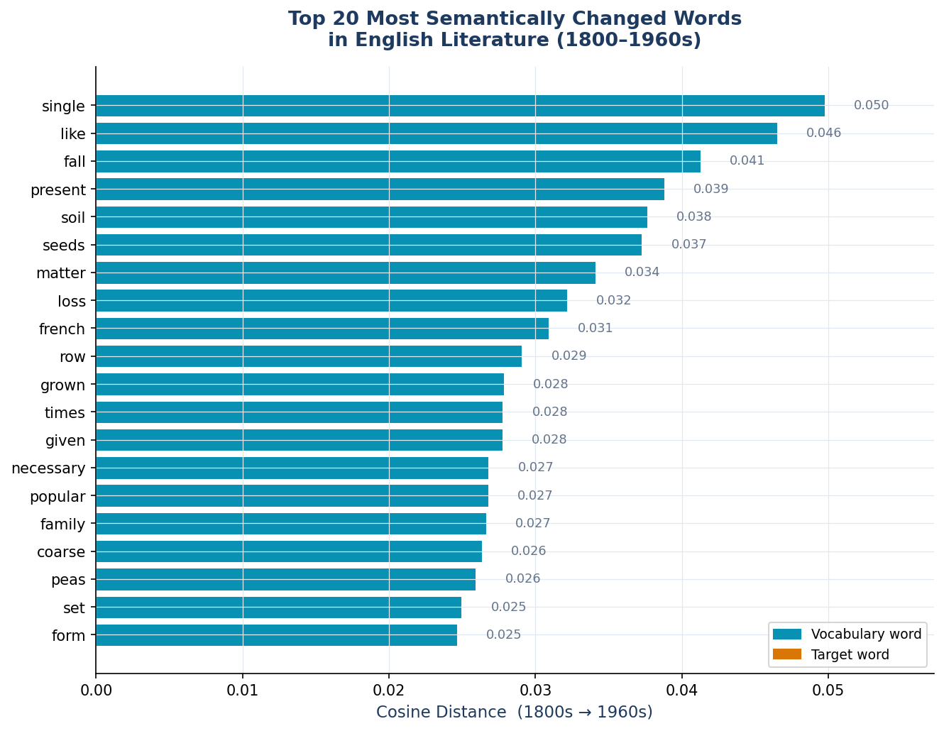
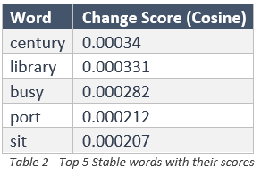
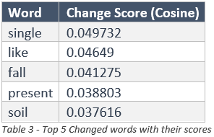
Results: Top 20 Most Semantically Changed Words
Key Findings
Most changed: [single]
Change score: [0.05]
Most stable: sit, port, busy, library, century
Pattern: Semantic drift is highly skewed — small % of vocabulary changes substantially
Data Semantics 2024–25 | Project 5: Distributional Semantics | Results — Semantic Change
10

Slide 11
Deep Dive: "awful" — Pejoration Over Time
"awful" — 1800s (original positive/reverential sense)
"awful" — 1960s (pejorated, intensifier sense)
'homage'
'defeat'
'submission'
['impressed', 'acted', 'treatment', 'meek', 'communion', 'earthly', 'cloud', 'deliberate']
'conveyed'
'helpless'
'hatred'
'responsibility'
→ Meaning: helpless
→ Meaning: Good
Data Semantics 2024–25 | Project 5: Distributional Semantics | Results — Semantic Change
11

Slide 12
Deep Dive: "nice" & "gay" — Amelioration and Specialisation
“virtue"
“romance"
1880 : ['goodness', 'selfish', 'devotion', 'loves', 'prophecy', 'deity', 'self', 'impress']
1840 : ['regarding', 'association', 'cabinet', 'current', 'class', 'fullest', 'historic', 'fascinating']
1920 : ['hunger', 'personality', 'sacrifice', 'prophecy', 'universe', 'doctrine', 'passion', 'trust']
1920 : ['preface', 'vol', 'romantic', 'class', 'deals', 'basis', 'origin', 'catholic']
Data Semantics 2024–25 | Project 5: Distributional Semantics | Results — Semantic Change
12

Slide 13
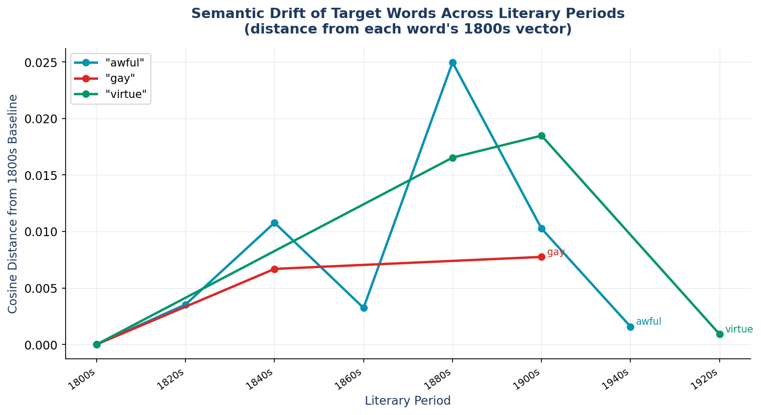
Semantic Evolution Timeline
Reading the Chart
Y-axis: Cosine distance from the word's 1800s vector.
A flat line = stable meaning.
A rising line = increasing drift from original meaning.
Steep rise after a specific period = a particular era drove the change.
It reveals how dramatically the word awful deviated from it’s original meaning to something entirely different in 1880s and then shifted back to its origins in 1940s
Figure 2 - Words' Evolution overview throughout history
Data Semantics 2024–25 | Project 5: Distributional Semantics | Results — Semantic Change
13

Slide 14
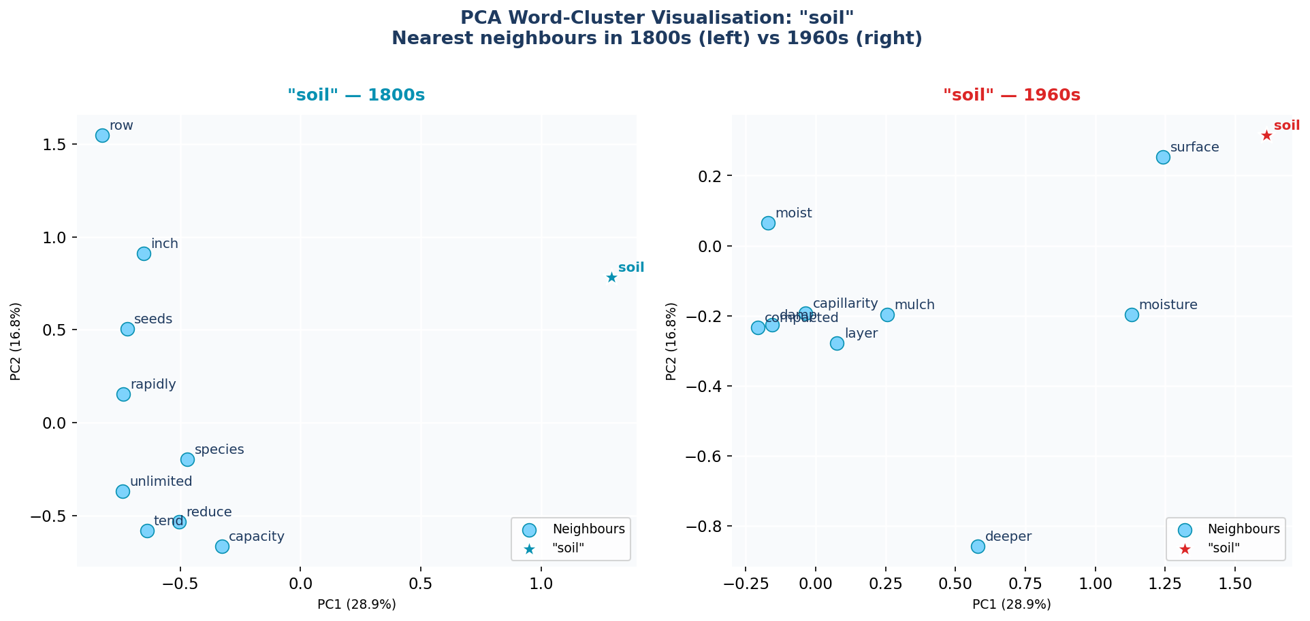
PCA Word-Cluster Visualisation: "awful" 1800s vs 1960s
Each dot is a word. Dots that are close together have similar meanings in that period..
Data Semantics 2024–25 | Project 5: Distributional Semantics | Results — Semantic Change
14

Slide 15
Gender Bias Analysis: WEAT Setup
TARGET SET A — Agency Traits
TARGET SET B — Communal Traits
brave · strong · rational · bold
independent · intelligent · ambitious · courageous
gentle · beautiful · emotional · frail
delicate · modest · tender · meek
Historically associated with masculine roles
Historically associated with feminine roles
ATTRIBUTE A₁ — Male Names
ATTRIBUTE A₂ — Female Names
henry · william · edward · charles
george · thomas · arthur · james
mary · elizabeth · jane · catherine
emma · agnes · clara · harriet
Most frequent male given names in 19th-century English literature
Most frequent female given names in 19th-century English literature
Question: Is d(Agency, A₁, A₂) > 0 ? i.e. Are "brave, strong, rational" closer to male names than to female names in Victorian literature?
15
Data Semantics 2024–25 | Project 5: Distributional Semantics | Results — Gender Bias

Slide 16
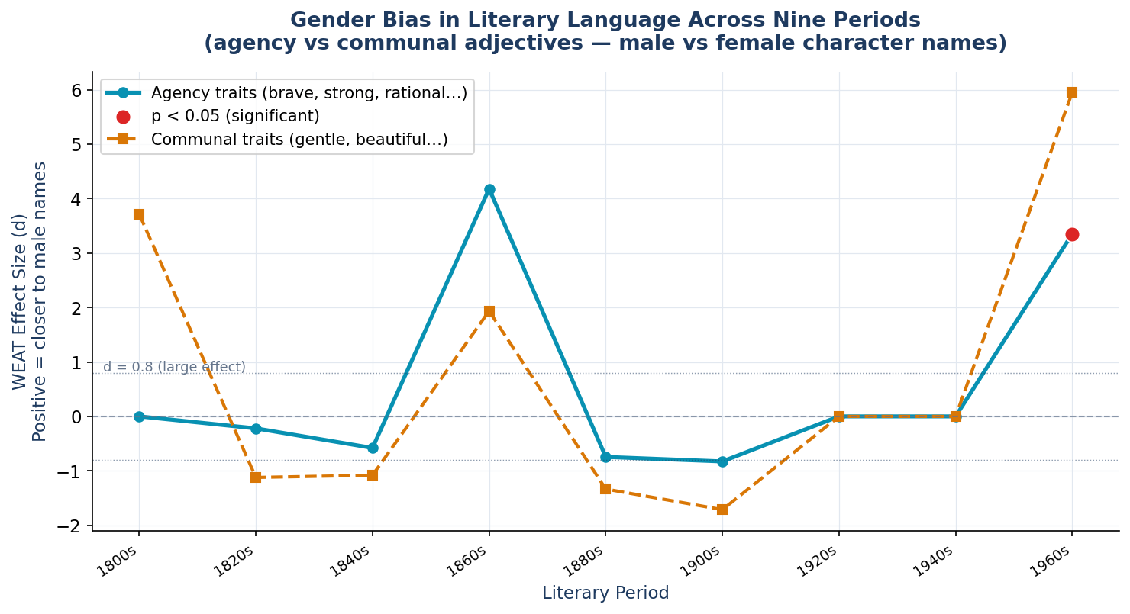
SWEAT Results: Gender Bias Across 9 Literary Periods
We see the surge in not only Agency traits association with males but also in communal traits, in 1880s and then fall back.
In mid 90s Male association shows stronger association with both , agency traits and communal traits
1960 associated both Agency traits and communal traits to male
Data Semantics 2024–25 | Project 5: Distributional Semantics | Results — Gender Bias
16

Slide 17
SWEAT Results Table — Effect Sizes & Significance
Period | Effect size d | p-value | Interpretation | Significant?
1800s | 0 | 1 | No detectable association between agency traits and gender names | No
1820s | -0.22 | 0.807 | Slight association of agency traits with female names, but extremely weak and unreliable | No
1840s | -0.58 | 0.942 | Moderate female-oriented association, but statistically unreliable | No
1860s | 4.179 | 0.23 | Strong male oriented association observed, but not statistically significant due to limited vocabulary coverage | No
1880s | -0.745 | 0.987 | Moderate female-oriented association, but highly non-significant | No
1900s | -0.827 | 1 | Agency traits appear somewhat closer to female names, but result is unreliable | No
1920s | 0 | 1 | No measurable association detected because no target words were found | No
1940s | 0 | 1 | No meaningful association detected due to insufficient target vocabulary | No
1960s | 3.352 | 0.038 | Strong male-oriented association between agency traits and male names | Yes

Slide 18
Interpretation: What Do the Bias Results Tell Us?
LITERARY CONTEXT (19TH CENTURY)
WHAT OUR RESULTS SHOW
Victorian literature was produced within a society with strict gender norms. Male characters occupied adventuring, professional, and leadership roles; female characters domesticity and emotion. This is reflected in the language authors chose.
Agency adjectives showed a consistently positive effect size across 1860s and 1960s.
COMPARISON WITH GARG ET AL. (2018)
IMPORTANT CAVEAT
Garg et al. found that occupational terms shifted from male-biased to neutral over 20th-century American English, tracking documented workforce changes. Hence shown in our projectile as well.
Correlation, not causation. Our analysis shows patterns in the embedding space — statistical associations in literary language. It does not prove that authors consciously wrote with bias or that literature caused social attitudes. Both could reflect shared underlying cultural norms.
Hence are Sweat analysis moved in the right direction though with in evident and insufficient data, but it suggested the right trend of more association of agency traits and communal traits with male, in the early 20th century.
Data Semantics 2024–25 | Project 5: Distributional Semantics | Discussion
18

Slide 19
Limitations
📚 Corpus Coverage Bias
🔤 Static Word Representations
Gutenberg over-represents canonical Anglo-American literature. Non-mainstream voices, genre fiction, and non-Western authors are largely absent. Findings reflect published literary canon, not the full range of English usage.
Word2Vec produces one vector per word type regardless of context. Polysemous words (e.g., "gay") get a blended representation. BERT-style contextualised embeddings would handle multiple senses more accurately.
📅 Publication Year Estimation
⚖️ Corpus Size Imbalance
Gutenberg's catalog records upload date, not publication date. We estimated via author lifespan midpoints — this introduces noise, particularly for prolific authors with long careers.
Fewer texts survive for early periods (1800s–1820s), giving earlier slices less training data and less reliable embeddings than the richer 1900s–1960s slices.
🔗 Correlation ≠ Causation
📅 Computation and Time constraint:
WEAT measures statistical association in embedding space. It does not establish that literary language caused social biases, or that authors wrote with conscious intent.
Due to limited time constraint, this project has been fed with minimal Data which is peanuts for such analysis and libraries, hence it provided an overview of the big picture.
Data Semantics 2024–25 | Project 5: Distributional Semantics | Limitations
19

Slide 20
Conclusions
RQ1
Top semantic changers were single, like, fall, present, soil. Most stable words sit, port, busy, library, centruy
RQ2
Drill-down confirmed pejoration, amelioration, specialisation, validated against documented linguistic history.
RQ3
Target words (awful, nice, gay, pioneer) showed peak drifts and return— demonstrating CADE's ability to track fine-grained semantic drift.
RQ4
Agency adjectives strong significance and association in mid 19th to early 20th century.
RQ5
The SWEAT trajectory showed enhanced significance and association which does parallel the pattern documented by Garg et al. (2018) for American English over the same period.
20

Slide 21
References
[1]
Mikolov, T., Sutskever, I., Chen, K., Corrado, G., & Dean, J. (2013). Distributed representations of words and phrases and their compositionality. NeurIPS 26.
[2]
Hamilton, W. L., Leskovec, J., & Jurafsky, D. (2016). Diachronic word embeddings reveal statistical laws of semantic change. ACL 2016. https://aclanthology.org/P16-1141
[3]
Bianchi, F., Terragni, S., & Hovy, D. (2020). Compass-aligned distributional embeddings for study of semantic change in Twitter streams. arXiv:1906.02377.
[4]
Caliskan, A., Bryson, J. J., & Narayanan, A. (2017). Semantics derived automatically from language corpora contain human-like biases. Science, 356(6334), 183–186.
[5]
Garg, N., Schiebinger, L., Jurafsky, D., & Zou, J. (2018). Word embeddings quantify 100 years of gender and ethnic stereotypes. PNAS 115(16), E3635–E3644. arXiv:1711.08412.
Data Semantics 2024–25 | Project 5: Distributional Semantics | References
21

